Slide 1
Immunity
By Mamita Rai Gurung

Slide 2
Antigen:
Antigens are substances (usually proteins) which when introduced in our body causes immune responses i.e.evokes humaral and cell mediated immunity. Antigens have one or more regions to bind with antibody, such specific regions are known as epitop or antigenic determinants,
Inorder to became an antigen /immunogen a substance must be of
Large size(> 10,000 KiloDalton)
chemical nature should be proteinous
Forgien
Degradation by enzymes

Slide 3
Types of antigen
1)Complete antigen:These are large molecular sized(>10,000 KiloDalton), proteinous substances that evokes both humoral and cellular immunity
2)Incomplete antigens(also known as haptens):these are usually small molecules (<10,000 KDa) non proteinous substances.That can bind especially to antibodies but can’t evokes the cellular and humoral immunity. So, for the haptens to became immunogens they need to bind with the carrier molecules(eg serum proteins)
examples of haptens are capsular polysaccharides, chemicals, drugs and lipids.
3)Microbial antigen:Example flagella, capsules, pilli etc
4)Heterophile antigen: These are the antigen that occur in unrelated organisms but are similar in the structures. Thus specific antibody produced against one antigen binds with another antigen i.e.cross reaction.Example A heterophil antigen present in Rickettsiae are shared by certain strain of Proteus.

Slide 4
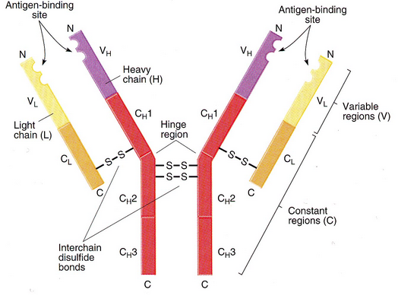
Antibody(Immunoglobulin)
Antibodies are proteinous substances which are produced specifically after an antigen enters the body.i.e. antibodies are produce against the antigen.The region of antibody that binds with antigen is called paratops.

Slide 5
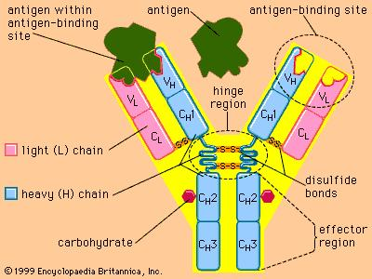

Slide 6
Structure of antibody is Y or T shaped.It contains two identical heavy chains and two identical light chains attached to each other by disulfide linkage. Each heavy chain and light chain is divided into upper variable region and lower constants region.
F_{ab}(fragment antigen binding) portion binds to antigen and F_{c}( fragments crystallization) portion is responsible for secondary biological functions like
activation of macrophages
activation of complements
Clearance of antigen-antibody complex

Slide 7
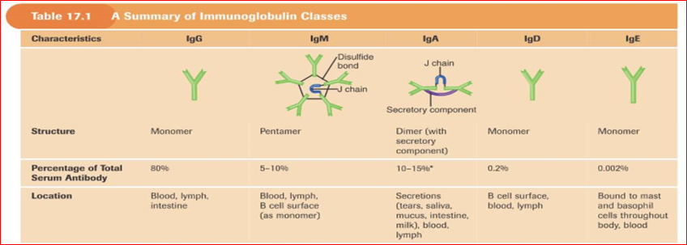

Slide 8
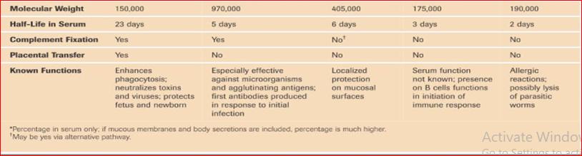

Slide 9
Immunology:Immunology is the sceince,which involves the study of specific and non specific body defence mechanism and how the immune system respond against the infectious agent. Simply immunology is the study of different aspects of immunity.
Immunity:
Immunity can be defined as the way in which body can protect itself from invasion by pathogenic microorganisms, toxic molecules and foreign cells and provide defense against their harmful effect.
Types of immunity
Innate immunity
Adaptive immunity

Slide 10
I. Innate immunity(Non specific/Natural immunity)
It provides 1st line of defense against infection. It provides rapid but non- specific disease resistant mechanism. It’s a life-long immunity.
Innate immunity comprises of 4 defensive barrier:
1 Anatomic barrier
2. Physiologic barrier
3. Phagocytic barrier
4. Inflammatory barrier

Slide 11
Anatomic barrier
It comprises of –skin and mucous membrane
Skin= Outer epidermis layer provides mechanical barrier whereas inner Sebaceous gland secrete sebum containing lactic acid and fatty acids that are bactericidal and fungicidal. Sweat gland on the other hand secrete sweats that are also inhibitory or lethal to microorganisms due to high salt concentration. Breaks in skin due to scratch, wound, abrasions and insect bites are obvious routes of infection.
Mucus membrane= Conjunctiva, alimentary, respiratory and urogenital tracts are lined by mucous membrane. Conjunctivae is freed of bacteria due to flushing action of tears and tears also contains lysozyme that is bactericidal. Saliva in mouth possess bactericidal action where as the anaerobes in colon secrete fatty acids with bactericidal activity. In genitourinary tract, the flushing action and acidic nature of urine maintains sterility of both male and female urethra. Similarly, Lactobacillus in vaginal region produce acids which are bactericidal to most pathogens.

Slide 12
2. Physiologic barrier
Physiological barrier includes; temperature, pH and various soluble and cell associated molecules. Body temperature and fever response also inhibits growth of some pathogens. Low pH Acidity of stomach contents kills most ingested microorganisms. Soluble chemical mediators like lysozyme cleaves bacterial cell wall. Interferon induces antiviral state in uninfected cells. Complement lyses microorganisms or facilitates phagocytosis. Similarly molecules like Toll-like receptors recognize microbial molecules, signal cell to secrete immune stimulatory cytokines. Collectins disrupt cell wall of pathogen.
3. Phagocytic barrier
Phagocytosis is a type of endocytosis(engulfment) and distruction of micro organisms conducted by specialized cells such as:- polymorphonuclear neutrophil and macrophages. Phagocytic cells are attracted to the site of infection by chemokines after which they engulf the bacteria and lysis with the enzyme.

Slide 13
Process of phagocytosis
Neutrophils are attracted by and move toward a variety of substances generated in an immune response; this process is called chemotaxis.
The next step in phagocytosis is adherence of the antigen to the neutrophils cell membrane.
Pseudopodia extend around the attached material.
Fusion of the pseudopodia encloses the material within a membrane-bounded structure called a phagosome, which then enters the endocytic processing pathway.
In this pathway, a phagosome moves toward the cell interior, where it fuses with a lysosome to form a phagolysosome.
Lysosomes contain lysozyme and a variety of other hydrolytic enzymes like acid hydrolases that digest the ingested material.
The digested contents of the phagolysosome are then eliminated in a process called exocytosis.

Slide 14
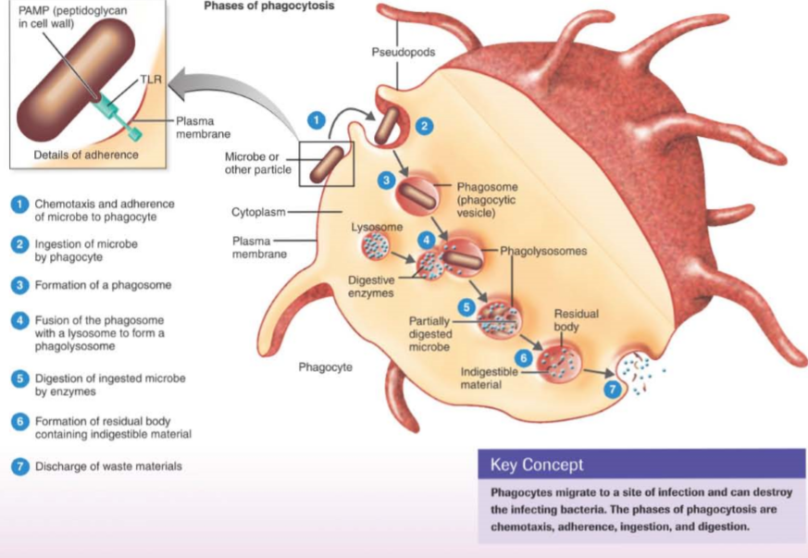

Slide 15
4. Inflammatory barrier
Inflammation is the process by which cells of immune system and their products concentrate at the site of infection. During acute inflammatory response certain plasma proteins collectively known as acute phase proteins like C reactive protein (CRP) increase dramatically. These acute phase proteins are supposed to play defensive role in the body.

Slide 16
II.Adaptive immune system(Specific/acquried immunity)
This is an immunity acquired by a person during life due to an antigenic stimulus.Here the body responses actively and specifically to an foreign substances such as infectious microorganisms. Adaptive immunity provides second line of defence mechanisms. Adaptive immunity destroy or inactivate the micro organisms and record information about it i.e. memory .Adaptive immunity is mediated either by antibody or the lymphoid tissues.
Types of adaptive immunity:
Active immunity
Passive immunity

Slide 17
Active immunity
Active immunity: This is when the body actively responds to a foreign substances or microorganisms by producing antibodies and often cell-mediated immunity. Active immunity develops slowly and persists for a long time. Active immunity occurs continuously naturally but can also be induced in a person by immunization or vaccination. Active immunity has 2 forms:
Humoral or antibody mediated immunity= here specific antibodies produced in the host combines with the corresponding antigen and modify their activity i.e. clumping or lyse of antigen molecule, neutralization of toxins and removal after phagocytosis. Antibodies are produced following the antigenic stimulation of B lymphocytes. The antigen binding receptor on a B lymphocyte is an immunoglobulin(Ig). When ﬁrst stimulated the B cell proliferates and differentiates into:
plasma cells which produce speciﬁc antibody
memory B cells which enable the immune system to react rapidly when the same antigen be encountered in the future (secondary response)

Slide 18
Antibody mediated immunity is the body’s main defence against extracellular pyogenic (pus-forming) bacteria such as staphylococci and streptococci, against capsulated bacteria such as pneumococci, Haemophilus and Neisseria species, and against toxin-producing bacteria such as Clostridium tetani, Vibrio cholerae, and Corynebacterium diphtheriae. Antibody immunity is also important in some virus infections, e.g. hepatitis B virus infection.

Slide 19
Cell mediated immunity= Here the cells involved are macrophages, helper T lymphocytes and cytotoxic T lymphocytes. Cell- mediated immunity is mainly directed at virus infected cells, intracellular fungi, and intracellular bacteria such as Mycobacterium tuberculosis, Mycobacterium leprae, and Brucella species. In cell mediated immunity, sensitized T cells after attachment with antigen releases lymphokines. These lymphokines causes stimulation of innate immune system, attract macrophage to the cell containing macrophage and kill the cell containing antigen by releasing cytotoxic agents.
Types of active immunity
Natural active immunity= it is acquired by natural infection by the organisms predominately by subclinical infections after repeated exposure to small doses of infecting organisms which pass unnoticed. Such immunity is usually long lasting. Ex: poliomyelitis, mumps
Artificial active immunity= it is the resistance produced by vaccination. Vaccines are the preparation of live, attenuated or killed microorganisms, or their antigen or active materials derived from them (eg: toxoids). Some commonly employed vaccines:
-bacterial vaccines (BCG, anthrax, plague and brucella vaccines)
-viral vaccines (small pox, measles, influenza, mumps, sabin poliomyelitis vaccine, salk vaccine for poliomyelitis)
-bacterial products ( toxins for tetanus and diphtheria)

Slide 20
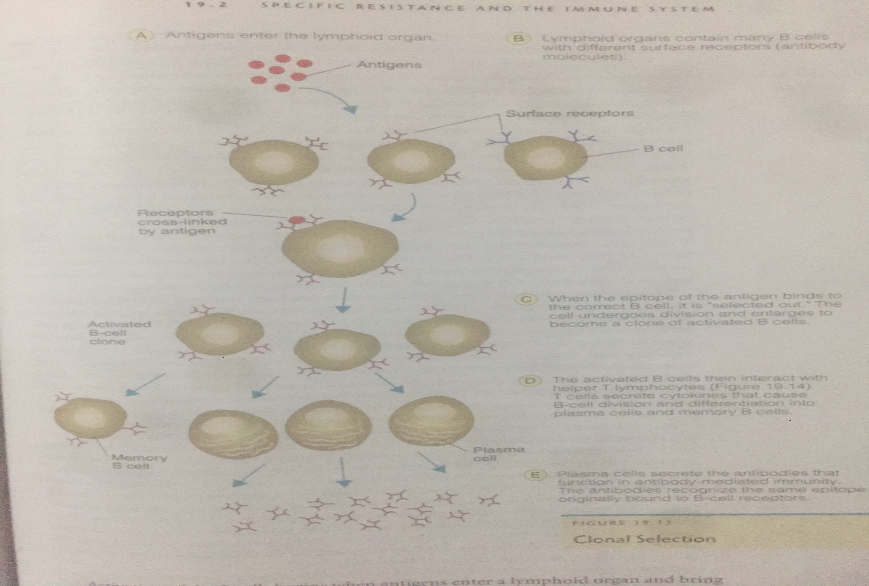

Slide 21
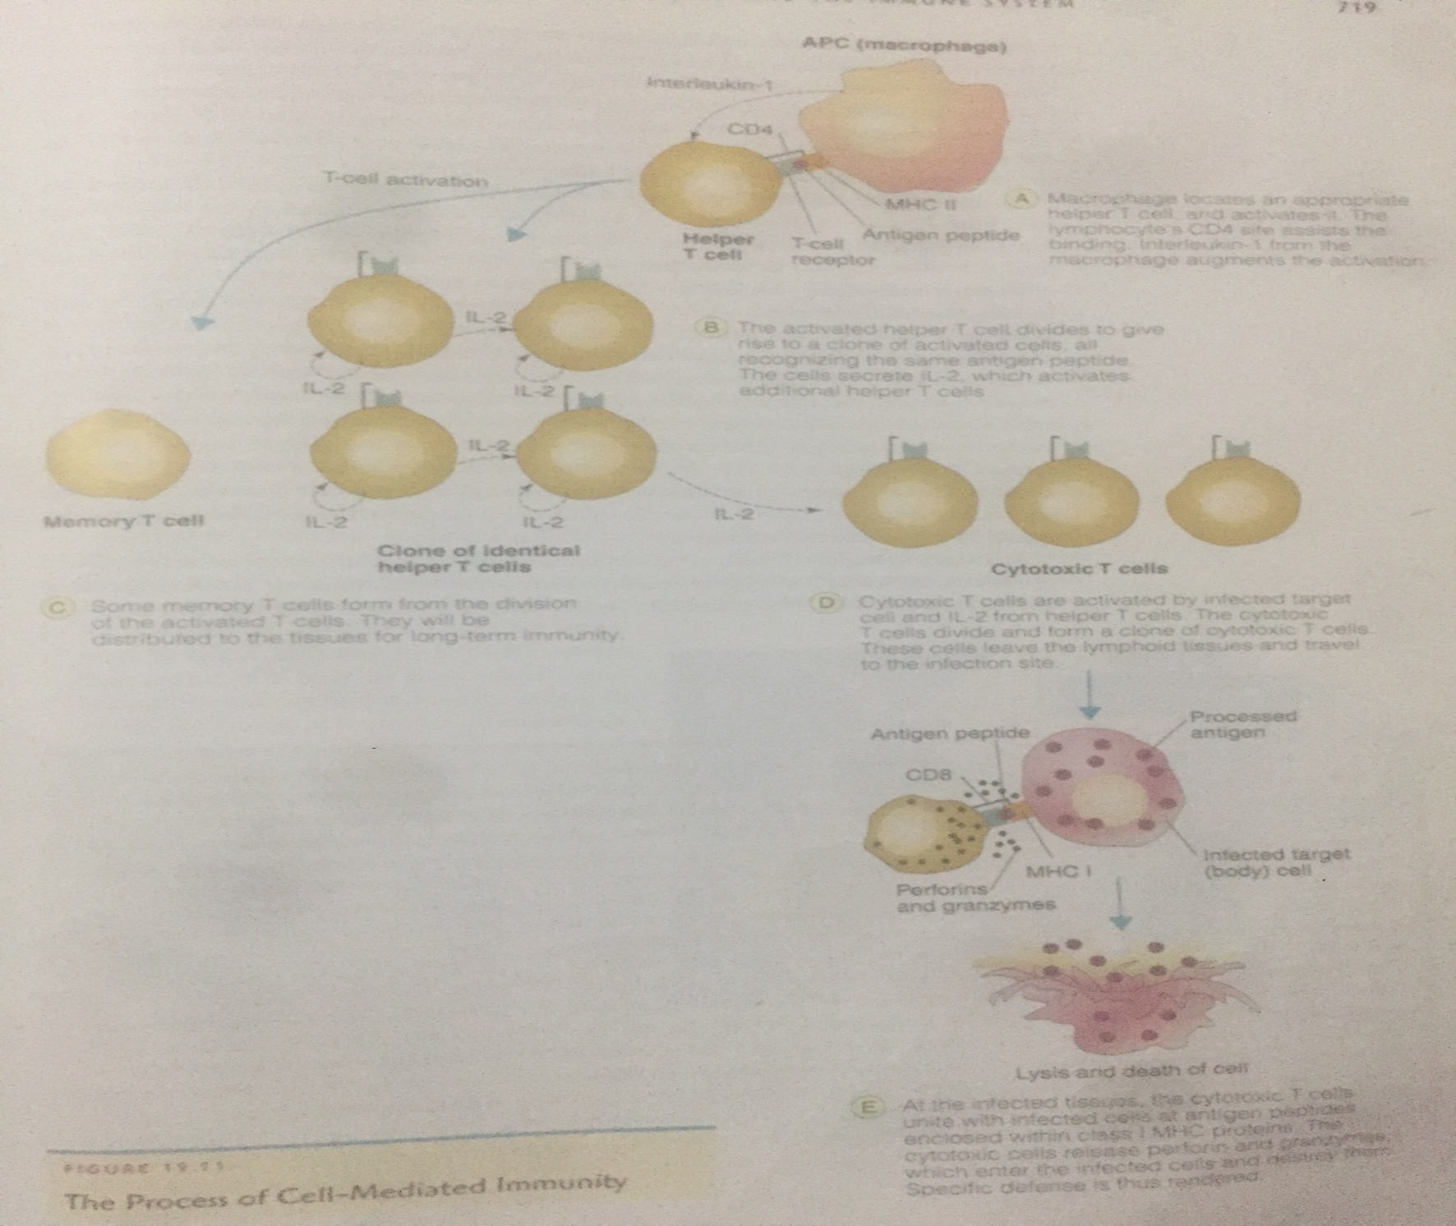

Slide 22
Passive immunity
Immunity achieve when antibodies are introduced into the body. These antibodies have been of another human or animal they will protect body against foreign substances or microorganisms. Here, the immune system plays no role and the protective mechanism comes into force immediately after transfer of antibodies. This immunity is short lasting.
Types of passive immunity
Natural passive immunity=resistance transferred from mother to foetus and infants. Ex; transfer of maternal antibody to foetus transplacentally and to infants through milk.
Artificial passive immunity= resistance transferred to a recipient artifically especially when the body doesn’t produce antibodies or does not produce rapidly enough.Antibody rich serum are usually injected into patients circulation.

Slide 23
Factors influencing immunity
Age=young children and people tend to be easily infected or suffer more serious infections Example: babies who are not breast fed are more susceptible because they do not receive human milk which contains IgA antibody and other constituents like complement and lysozyme that help to protect from infection. In older people less active immunity is seen due to aging process, chronic illhealth, poor circulation and poor nutrition.
Malnutrition and undernutrition= protein energy malnutrition and undernutrition often combined with chronic diarrhoea, greatly weakens immune response in children. Vitamins deficiency also contributes to reduced immunity.
Pregnancy= immunity is lowered during pregnancy and risk of microbial infection increases especially in poorly nourished mothers.
Infections=many bacterial, viral and parasitic infections affect immunity. Eg: HIV
Genetic factors=certain genes are responsible for immune disorders specially those genes that lead to the deficiency in the production of B and T lymphocytes, PMN and complement.
Drugs=certains drug are toxic not just to malignant cells but also to the cells involved in immunity.

Slide 24
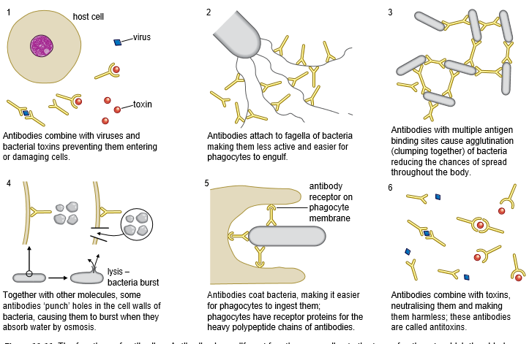

Slide 25
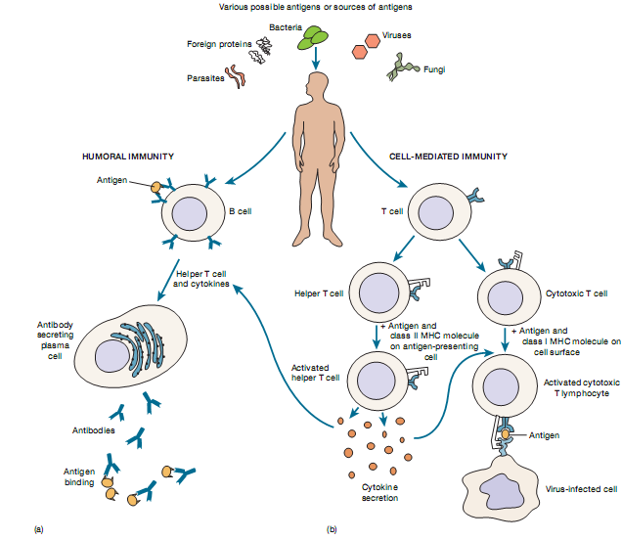

Slide 26
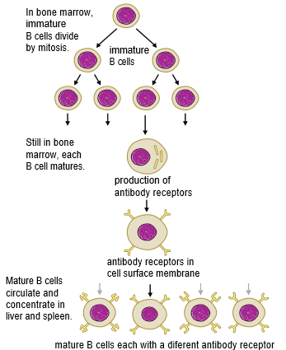
B-lymphocytes

Slide 27
Other natural immunity:
Species immunity:
A micro organisms pathogenic to one species of animal may not be pathogenic to another species .Example Neisseria gonorrhoea can infect humans and chimpanzees but other animal.
Racial immunity:
With one species such as humans, there may be marked differences in susceptibility based on racial and genetic differences.Example Black people show a relative high resistance to tropical diseases such as malaria and yellow fever.
Individual immunity:Some people experience fewer infection than other though they are of same racial background and are equally exposed to the infections.Example Young individuals are susceptible to measles and chickenpox similarly aged people are susceptible to diseases like pneumonia.

Slide 28
Immune system
Organization of cells, factors and process
Basically cells called lymphocytes are involved
Present all over the body n comprises lymphoid system , small size cell 10- 20 micrometer with centrally located nucleus that cover maximum area of the cell cytoplasm
Microscopically all lymphocytes are same but according to development history, cellular function and unique biological functions two types- B lymphocytes and T lymphocytes

Slide 29
B- lymphocytes provide immune resistance by production of antibodies and T lymphocytes- by cell to cell interactions

Slide 30
Development
After Fetus conceive of two months immune system arises.
Lymphocytes originates from primitive cells of yolk and bonemarrow called as hematopoietic stem cell.
These cell differentiate into two-myeloid progenitor cell and lymphoid progenitor cell
Myeloid develops into RBC and WBC
Lymphoid develops into lymphocytes that is B cell and Tcells

Slide 31
T lymphocytes
some lymphoid progenitors leaves the bonemarrow and proceed to the organ of thoracic cavity called thymus
It’ s the bilobed organ present just below the thyroid gland near the top of the heart.
Within the thymus the progenitor cells mature with two to three days nad modified by addition of cell surface receptor.
Than spread on the lymph nodes, spleen, tonsils other lymph organ
Present on medulla

Slide 32
B lymphocytes
Mature in the Bone marrow and called B lymphocytes
Posses surface receptor proteins.
Than spread on the lymph nodes, spleen, tonsils other lymph organ
Present on the cortex

